Slide 1
Final Project Summary Alex Barkovitch CMP 262

Slide 2
Tools used: Jupyter Notebook
Python Packages:
pandas numpy matplotlib seaborn

Slide 3
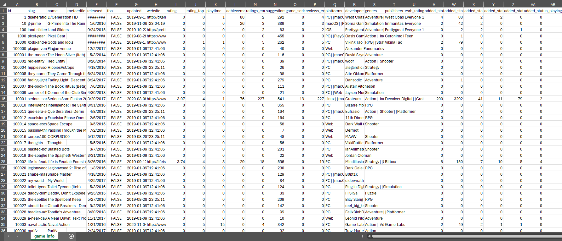
Video Game Data Analytics Dataset: https://www.kaggle.com/datasets/jummyegg/rawg-game-dataset/data
3

Slide 4
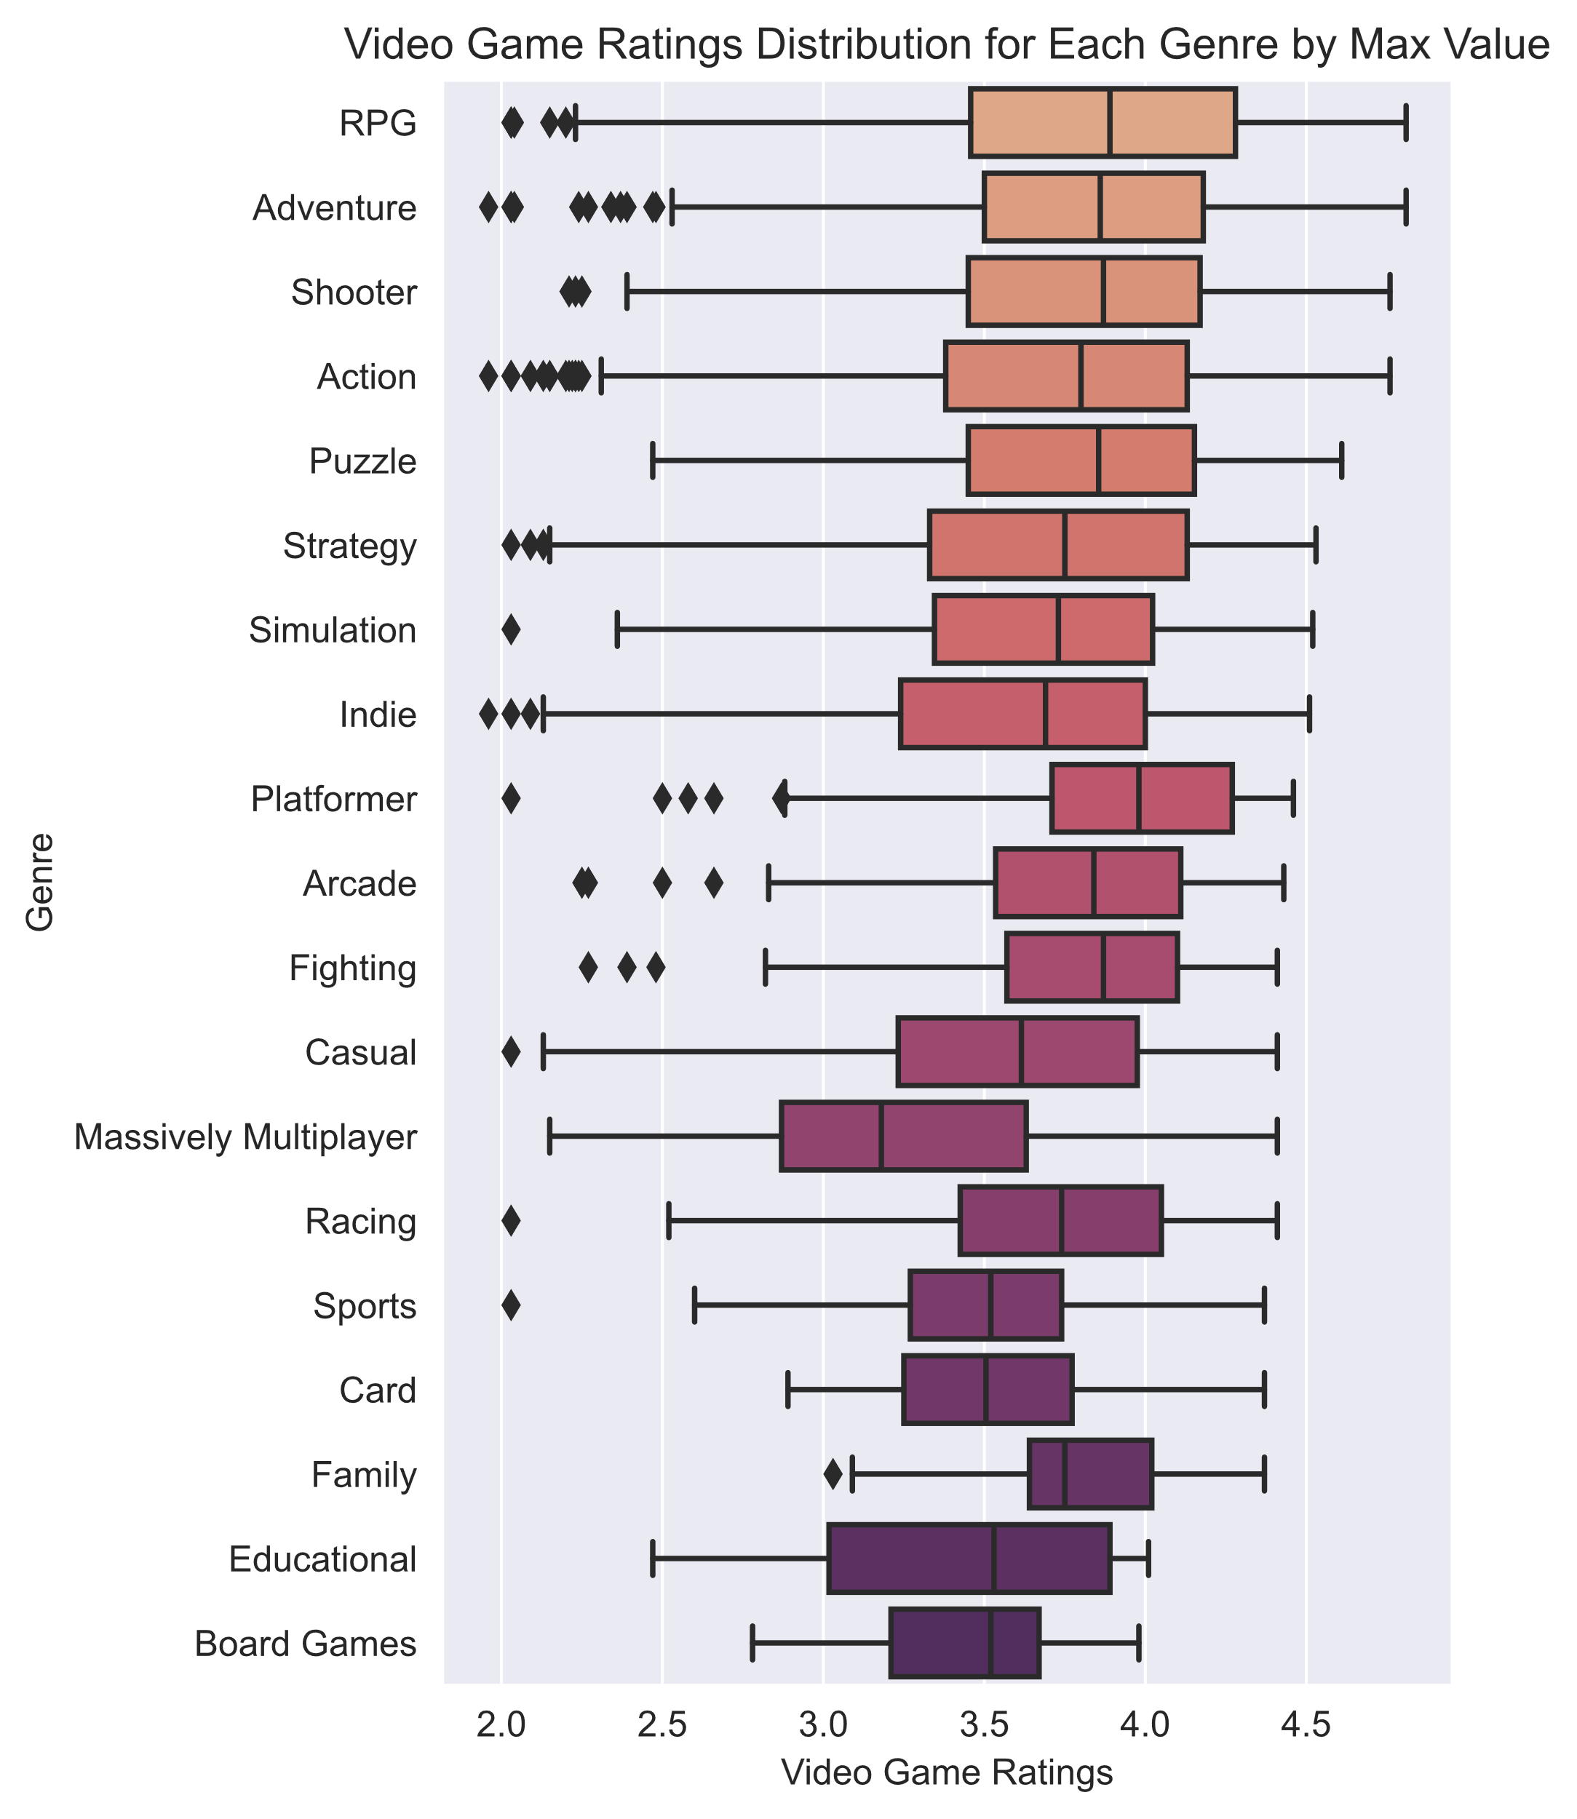
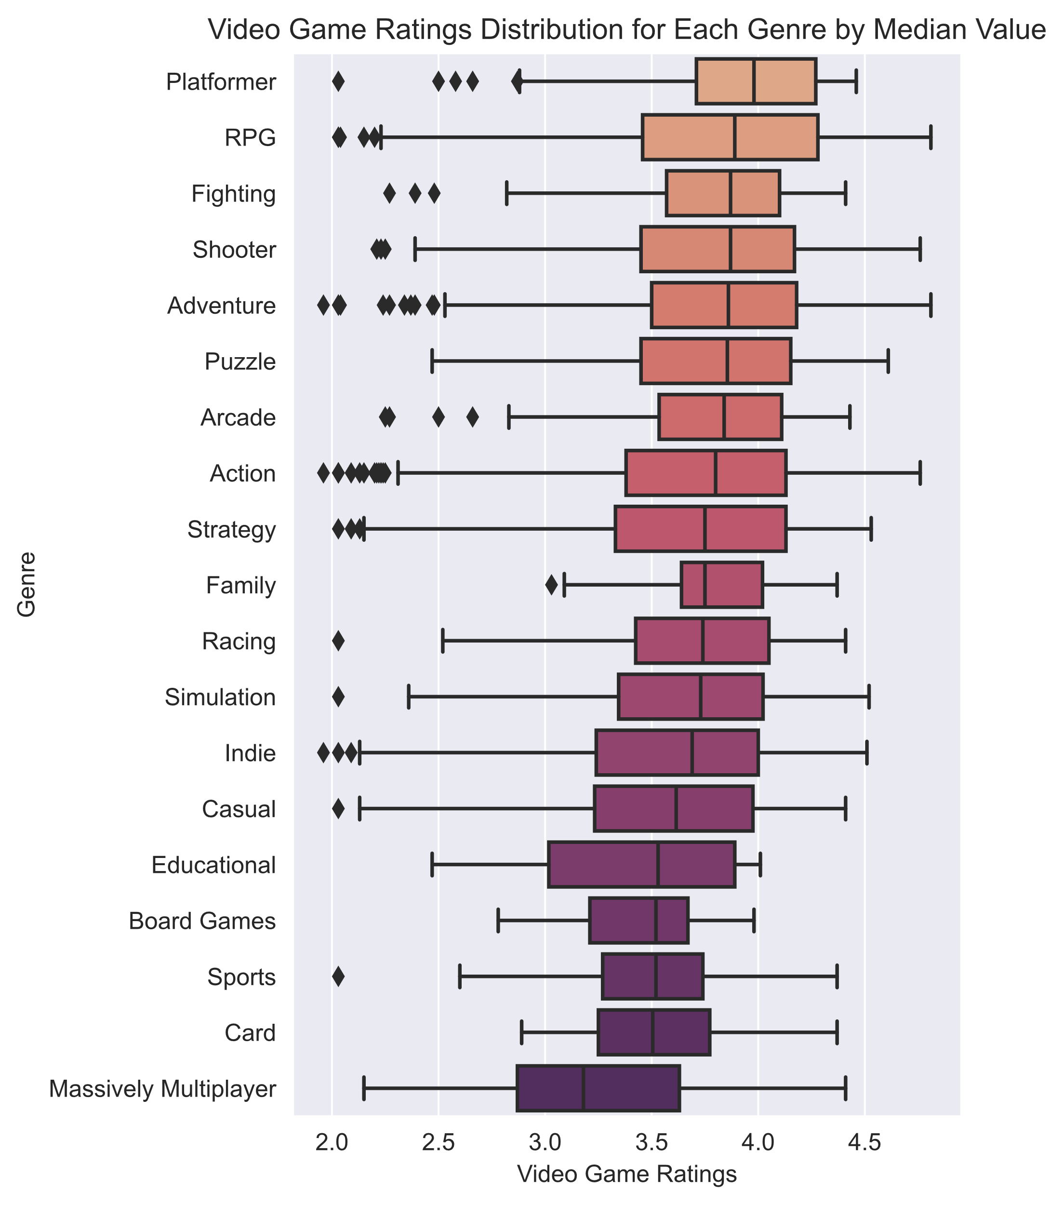
Which genres have the highest ratings?
4
This data shows that RPGs, Adventure, Shooter, and Platformer games are the most popular genres.
Developers would likely have better luck creating games in these genres than making MMO or board games.

Slide 5
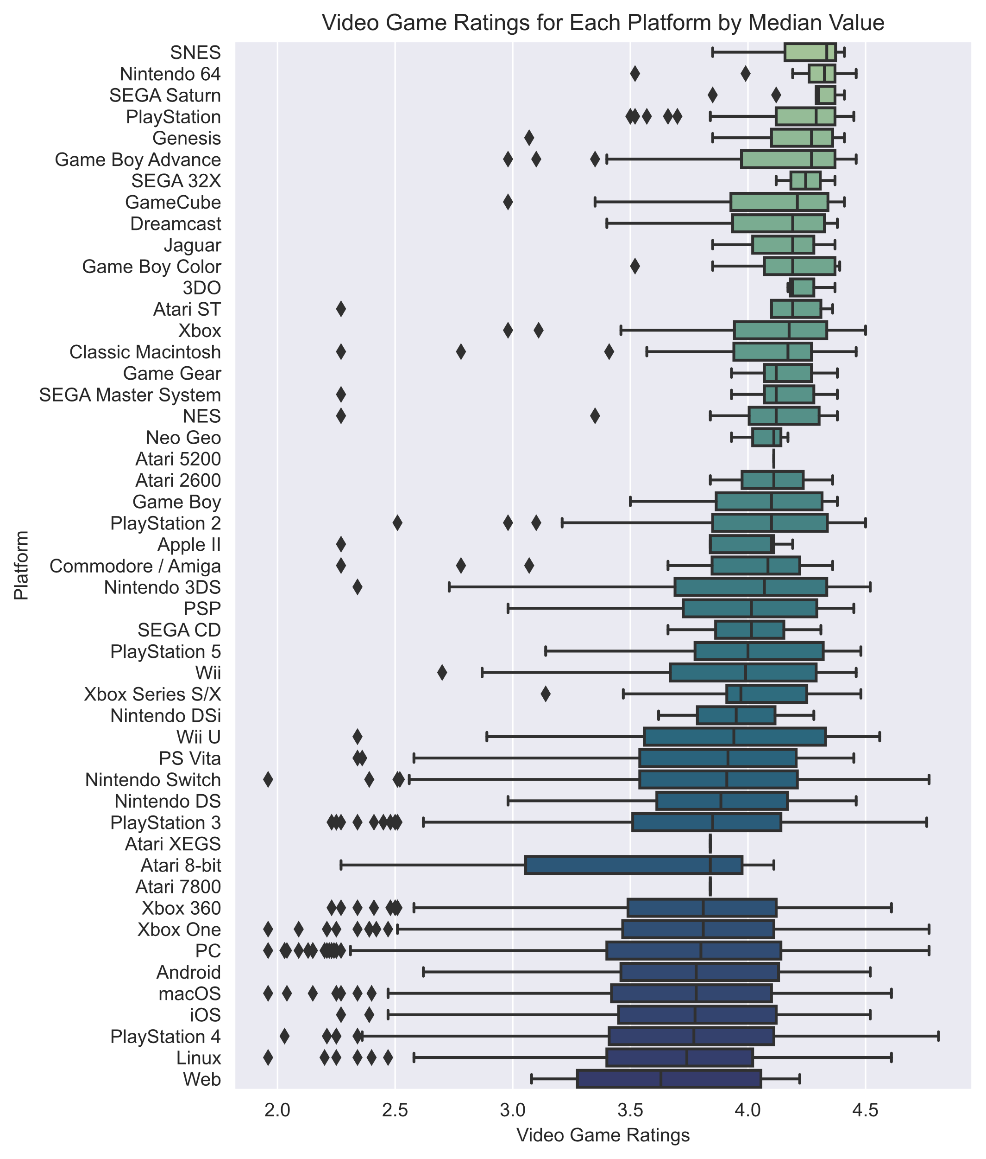
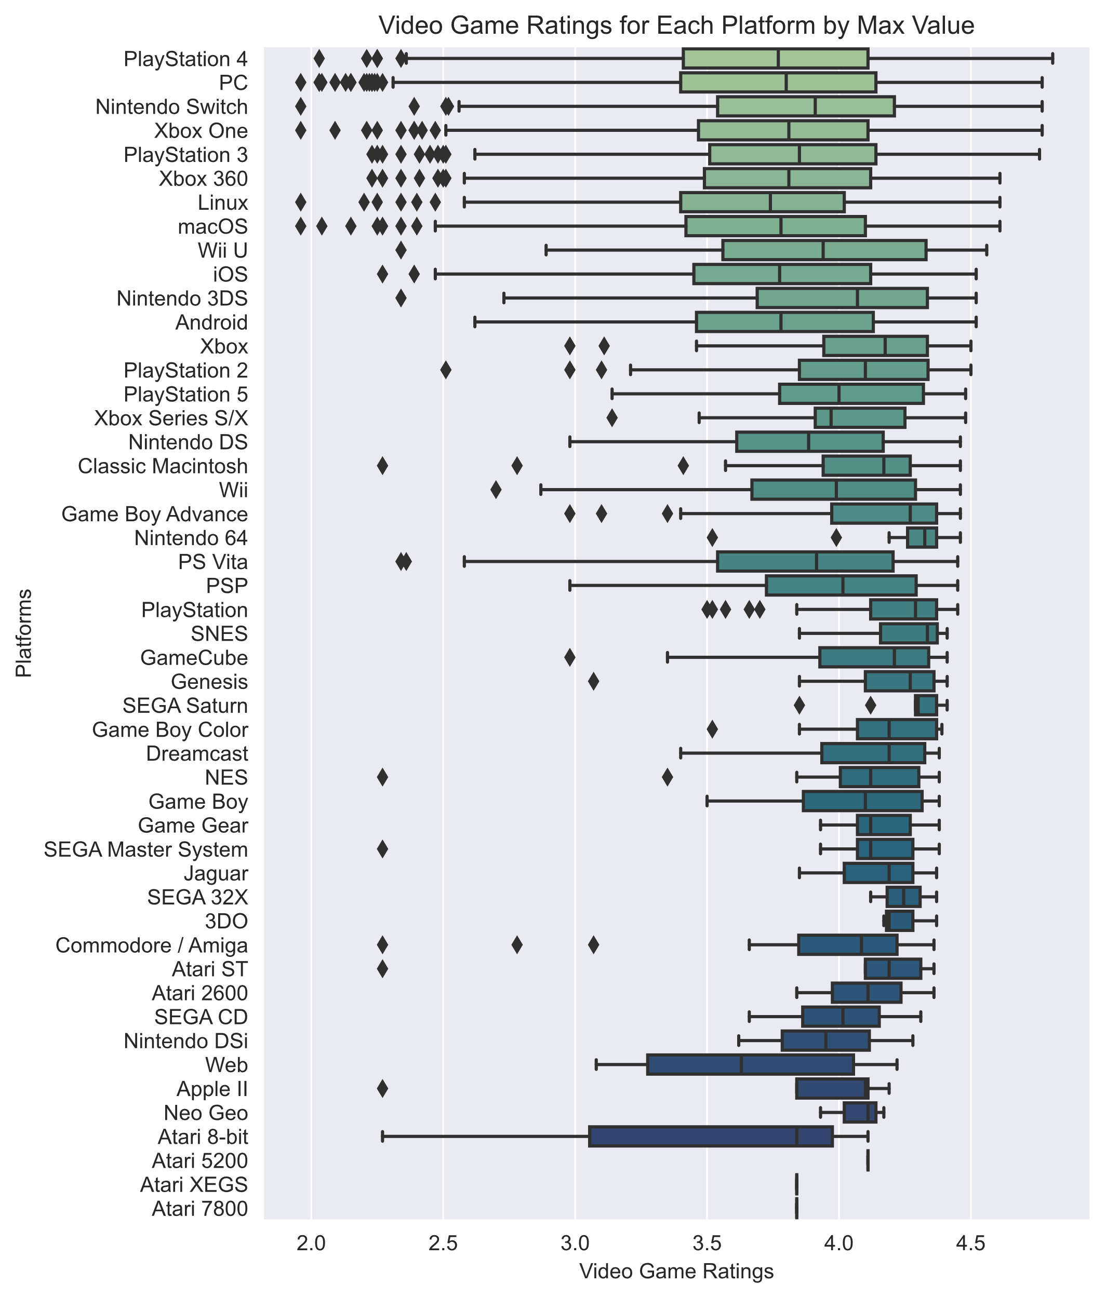
Video Game Ratings for Each Platform
When looking at the data for platform ratings, it’s a bit harder to identify a clear winner. While PlayStation 4 has the highest maximum rating, it has the third lowest mean. PC is also at the top of the max value list, but the bottom of the median ratings.

Slide 6
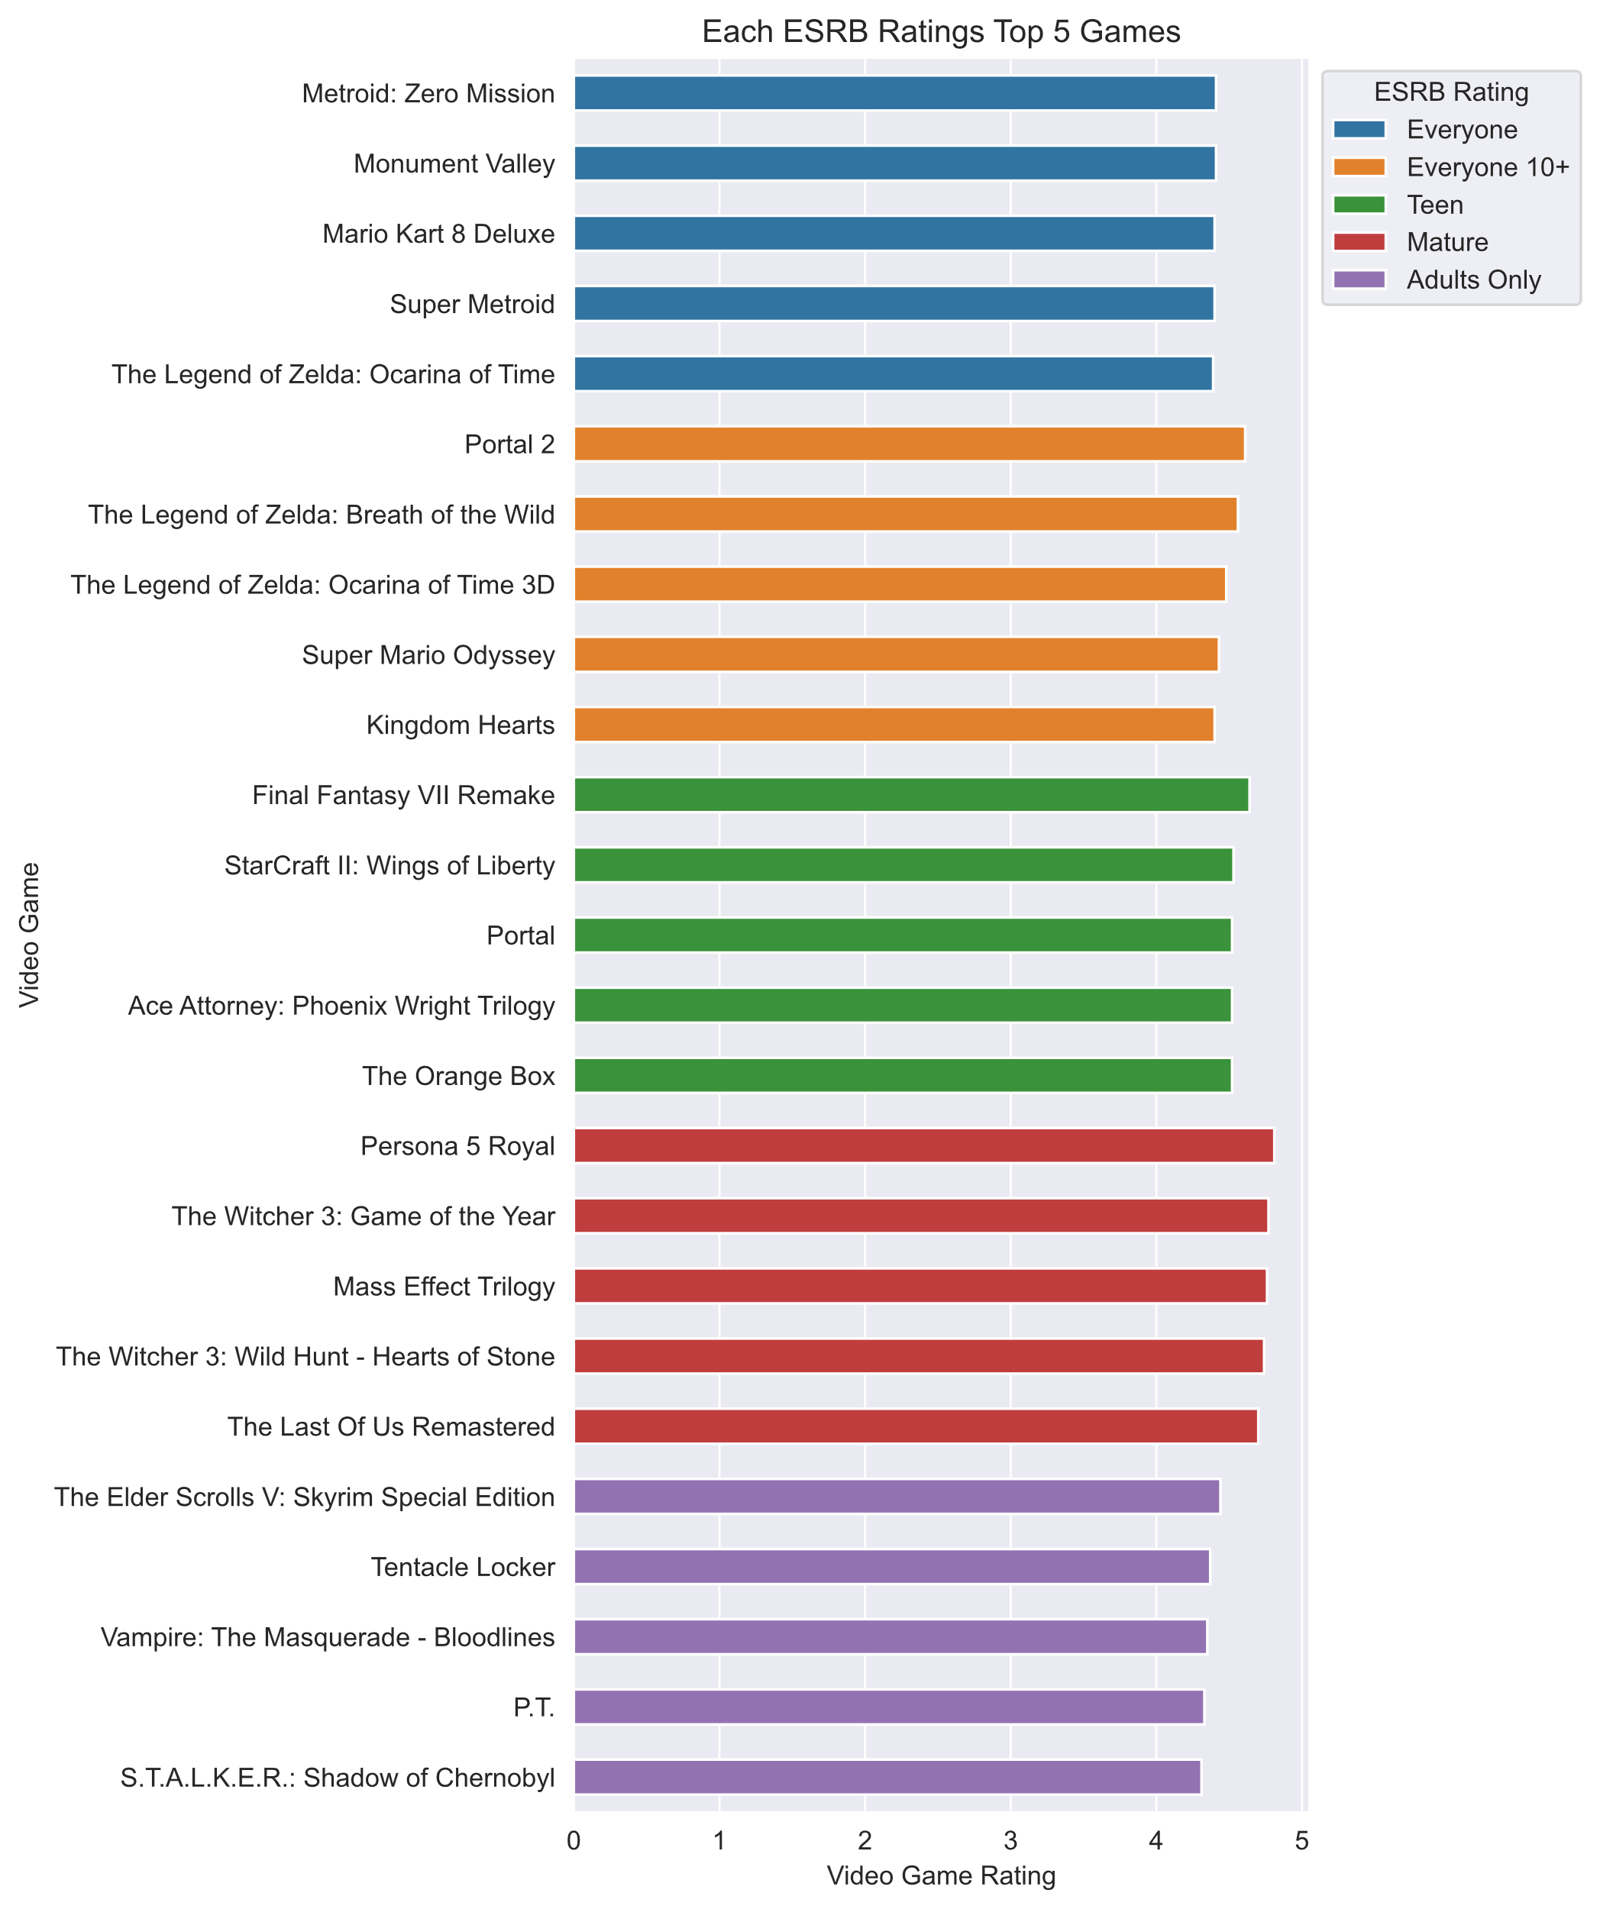
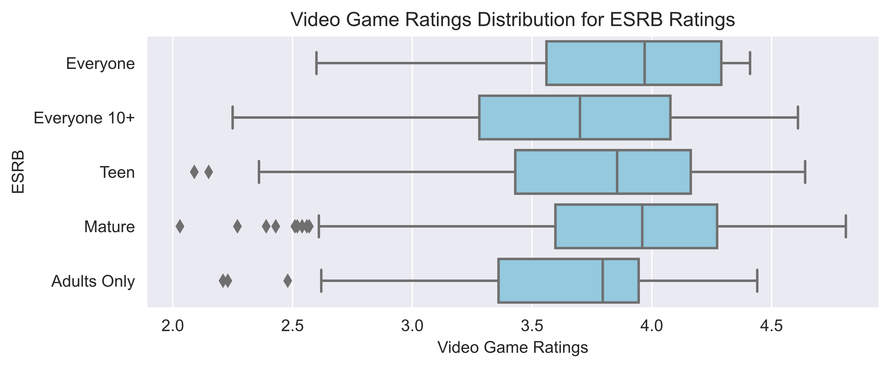
Popular ESRB Ratings
Persona 5 Royal is the highest rated game in this dataset, and it’s rated Mature. Mature games have the highest max ratings, but for a developer looking to play it safe, games rated for Everyone also see success, with a very consistent average rating.

Slide 7
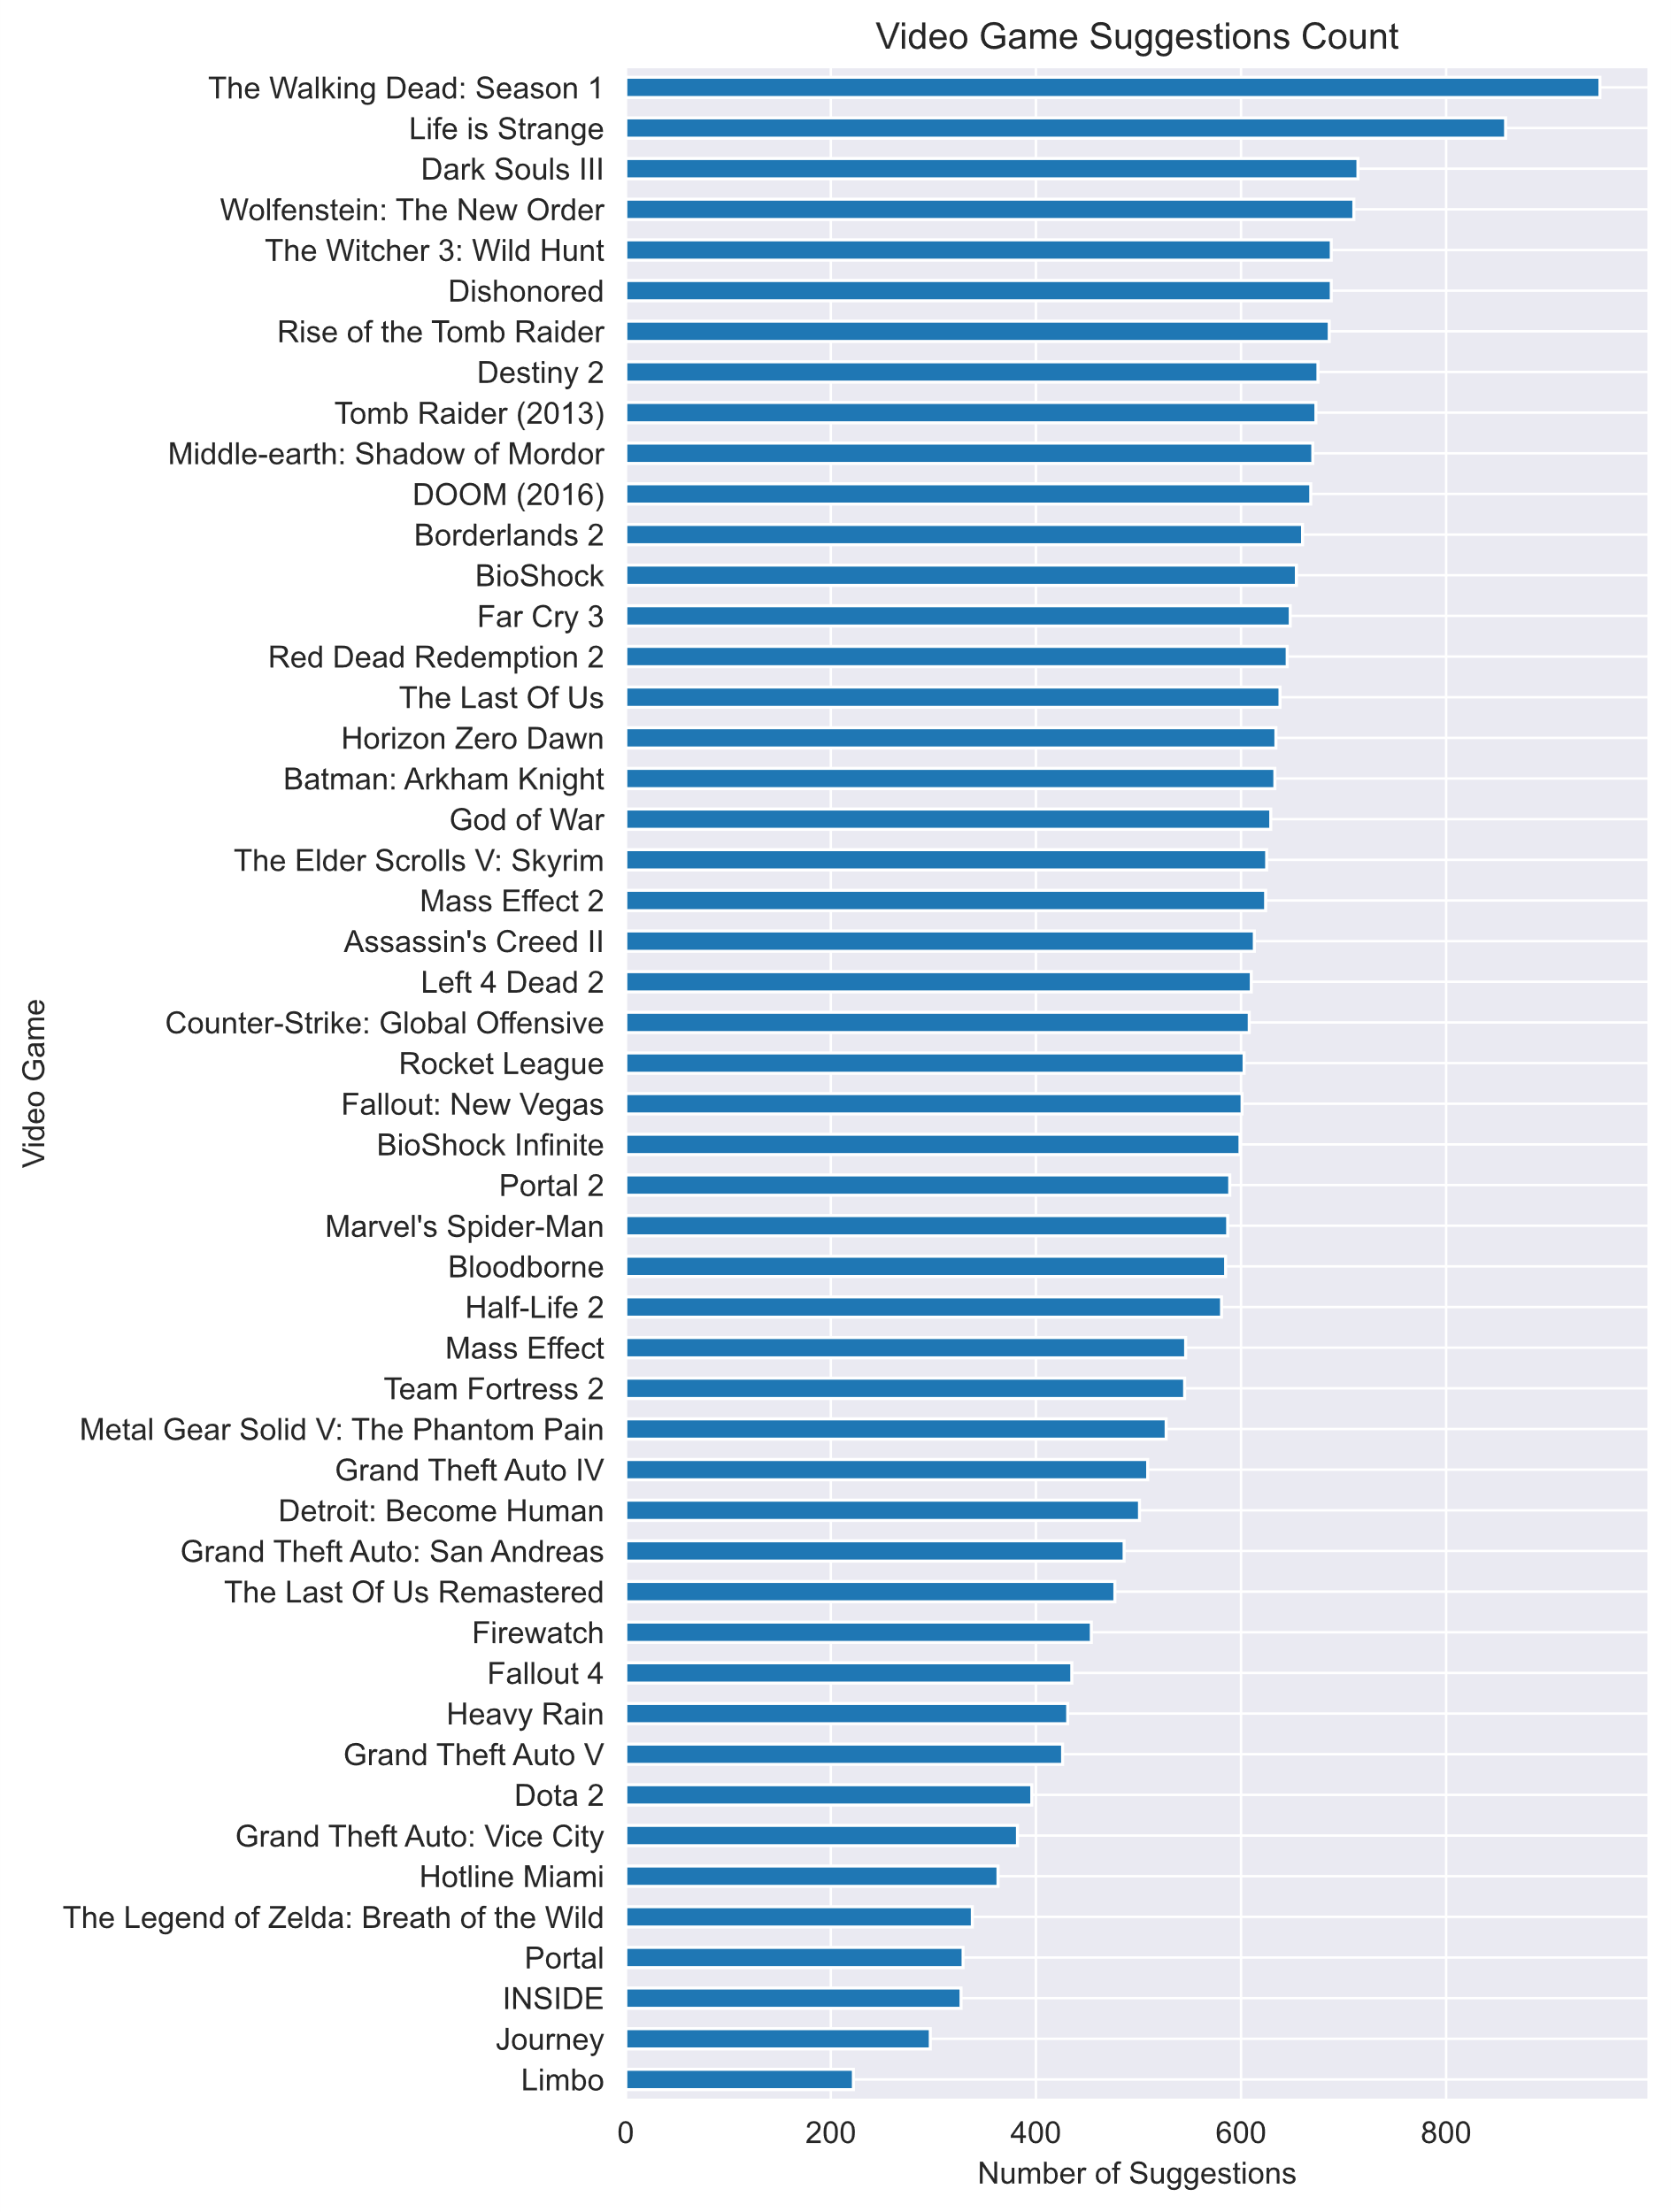
Top Recommended Games
The top 2 suggested games are The Walking Dead: Season 1 and Life is Strange, which both have significantly more suggestions than the 3rd on the list, Dark Souls III. While ratings are more important than suggestions count, developers can still take inspiration from the top games on this list.

Slide 8
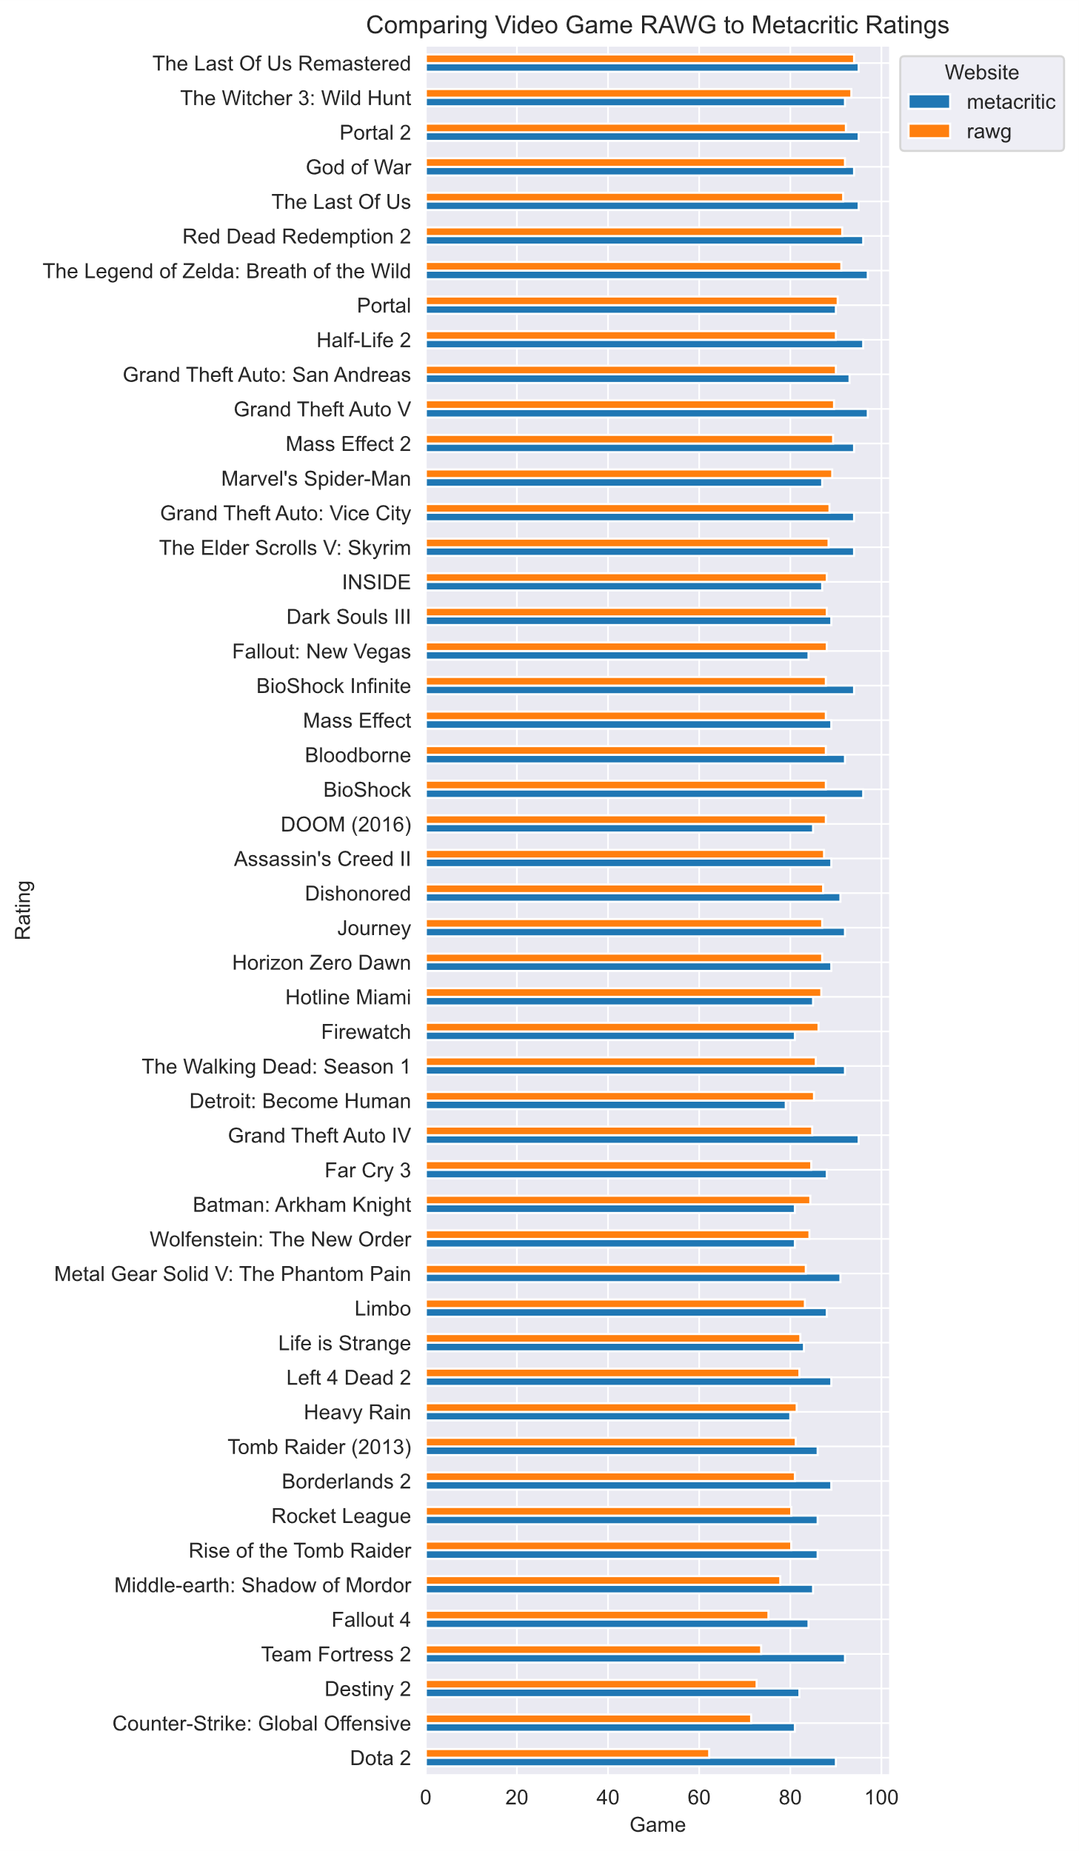
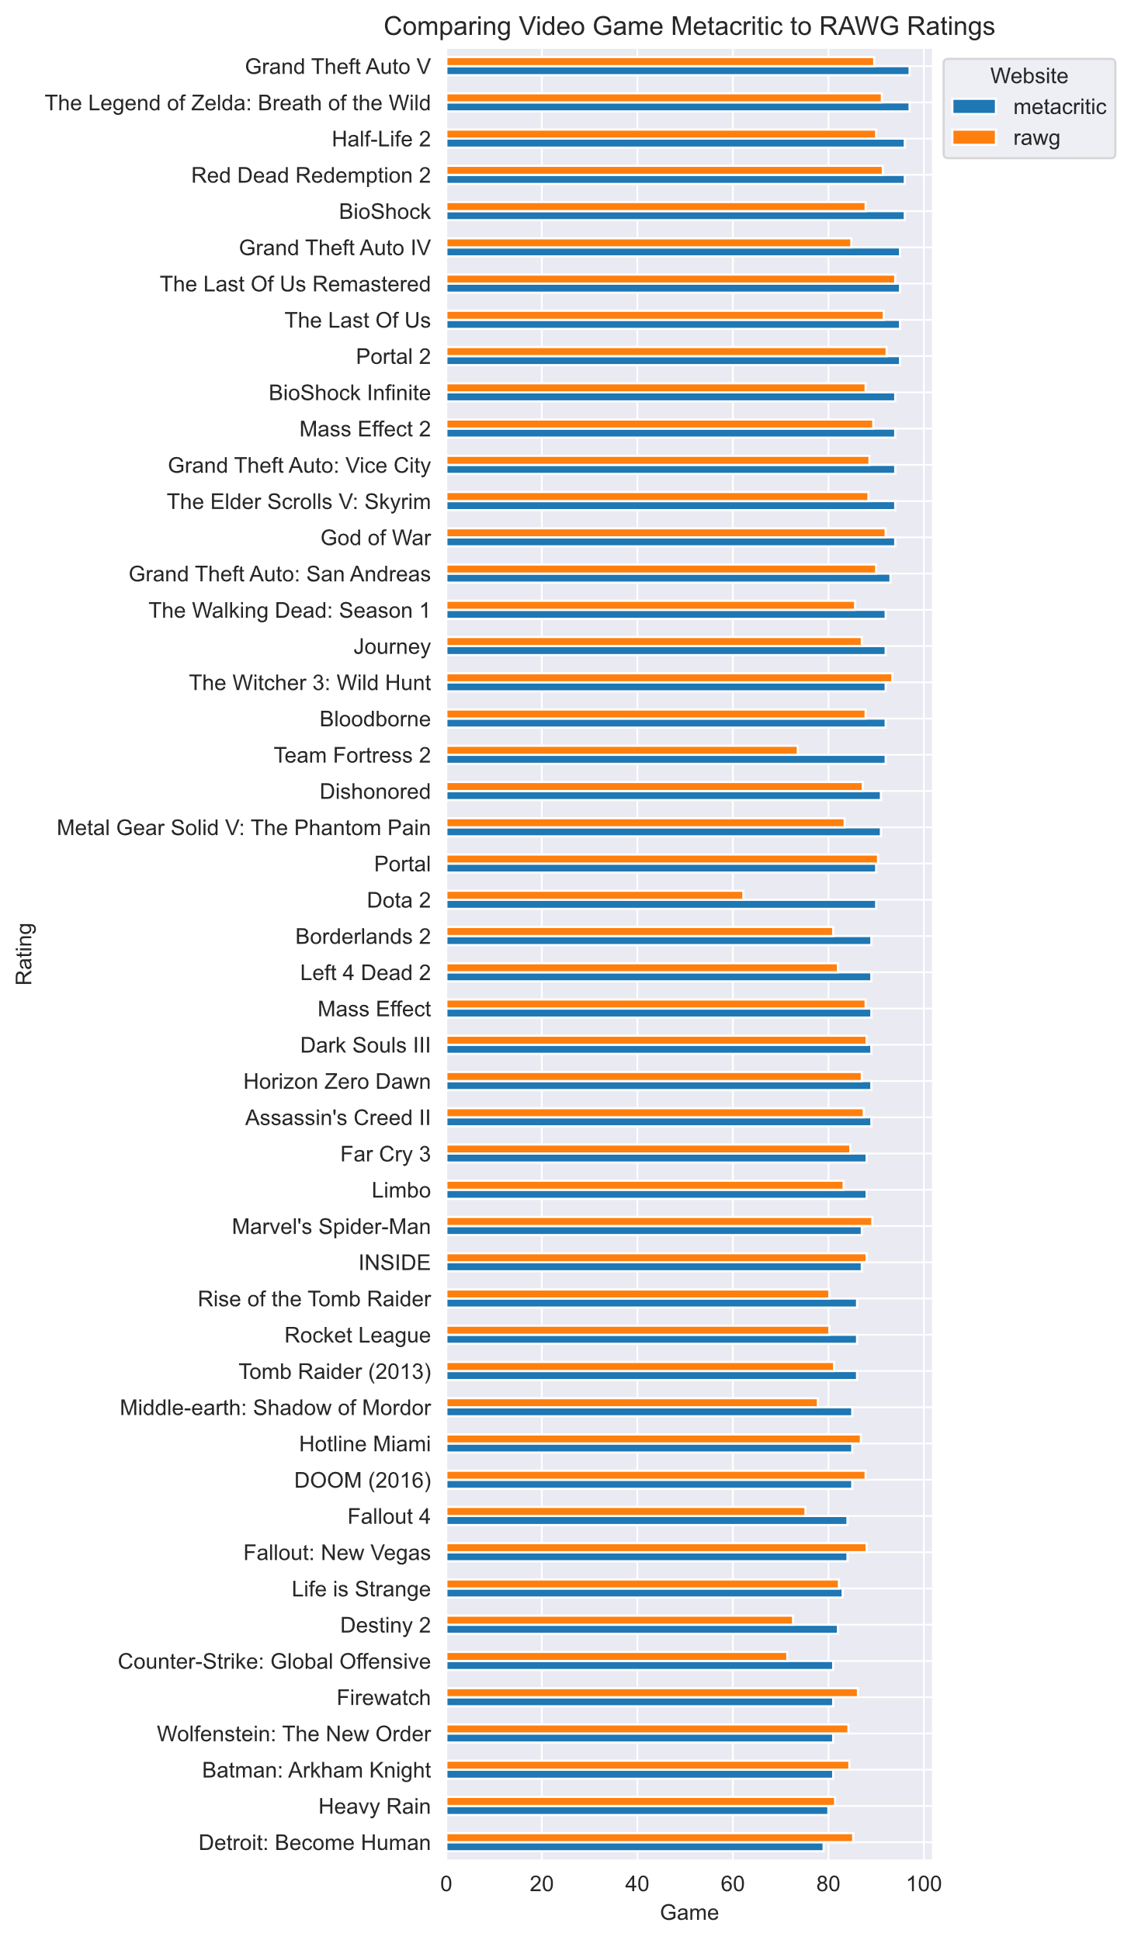
Comparing Ratings on Different Sites
I took the ratings from Metacritic and from RAWG and compared them side by side to see how different sites rated the same games. I wasn’t expecting quite so many differences, especially how Dota 2 is the bottom rated game in the RAWG list but is in the middle of Metacritic, who rated it about 30 points higher.

Slide 9
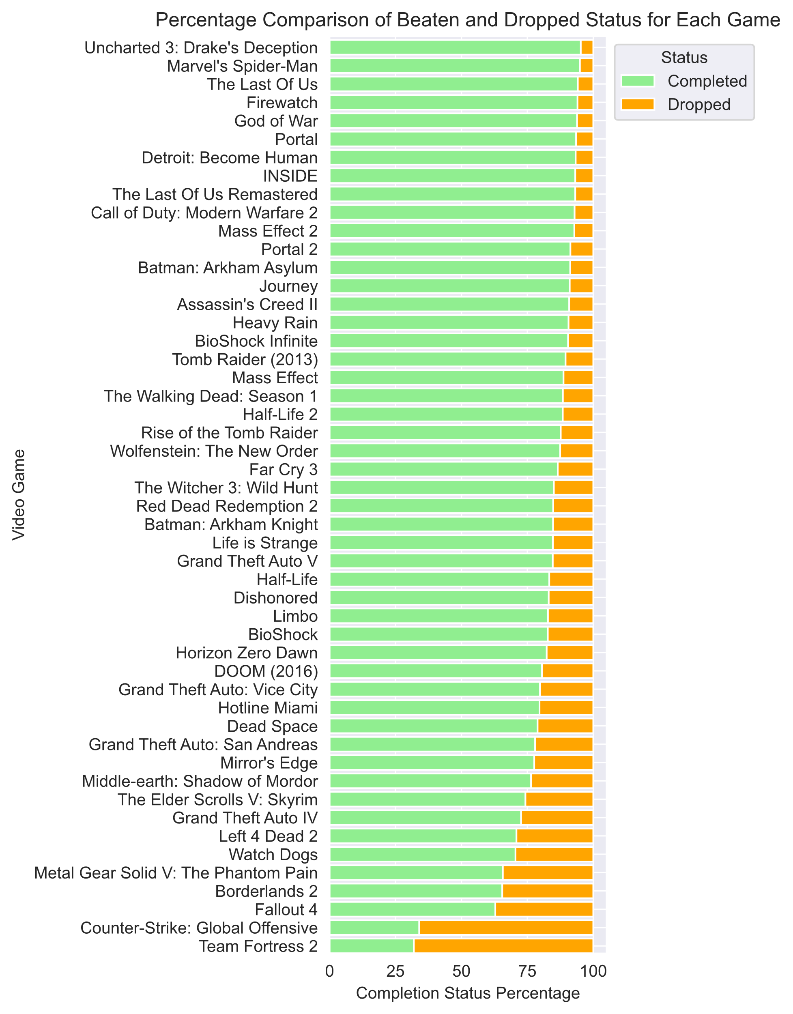
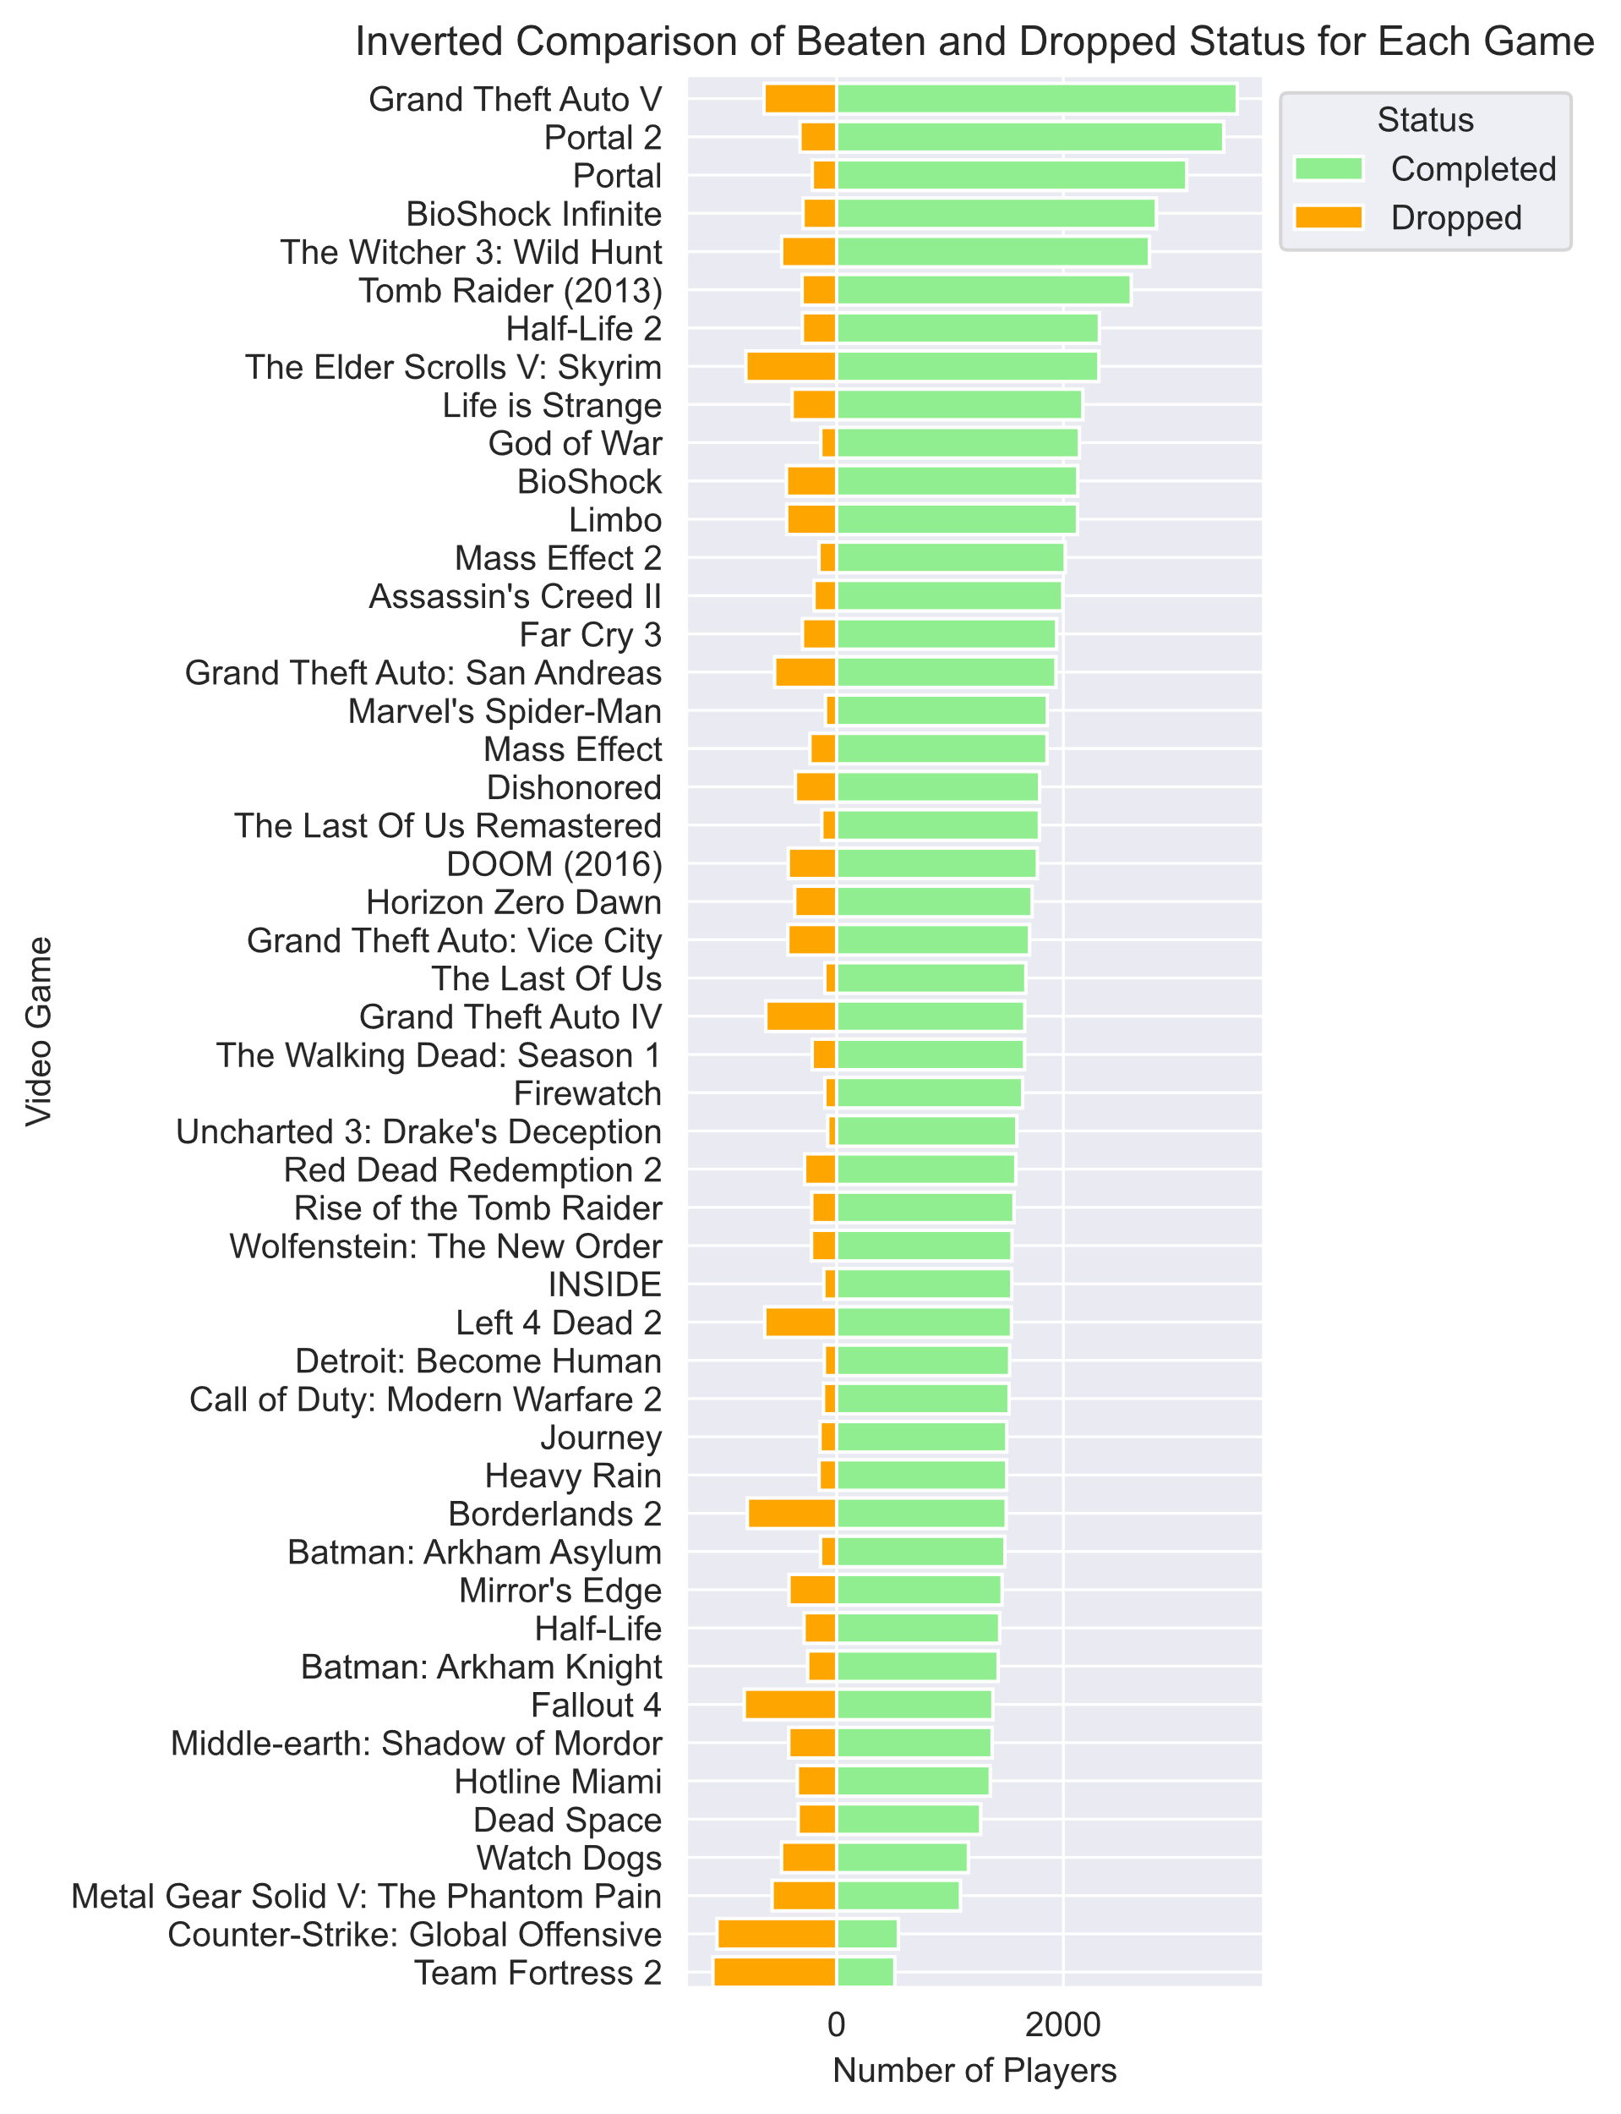
Game Completion Status
For these plots, I took the number of RAWG players who marked a game as completed or dropped. I wanted to see if games that completed more had higher ratings. Grand Theft Auto V has the highest number of completions, and is the top game in our Metacritic ratings. The Last Of Us has the 3rd highest completion rate and has the 5th highest rating, so there does seem to be a correlation.

Slide 10
Thank You
I hope you gained some insights from my analysis!

